Slide 1
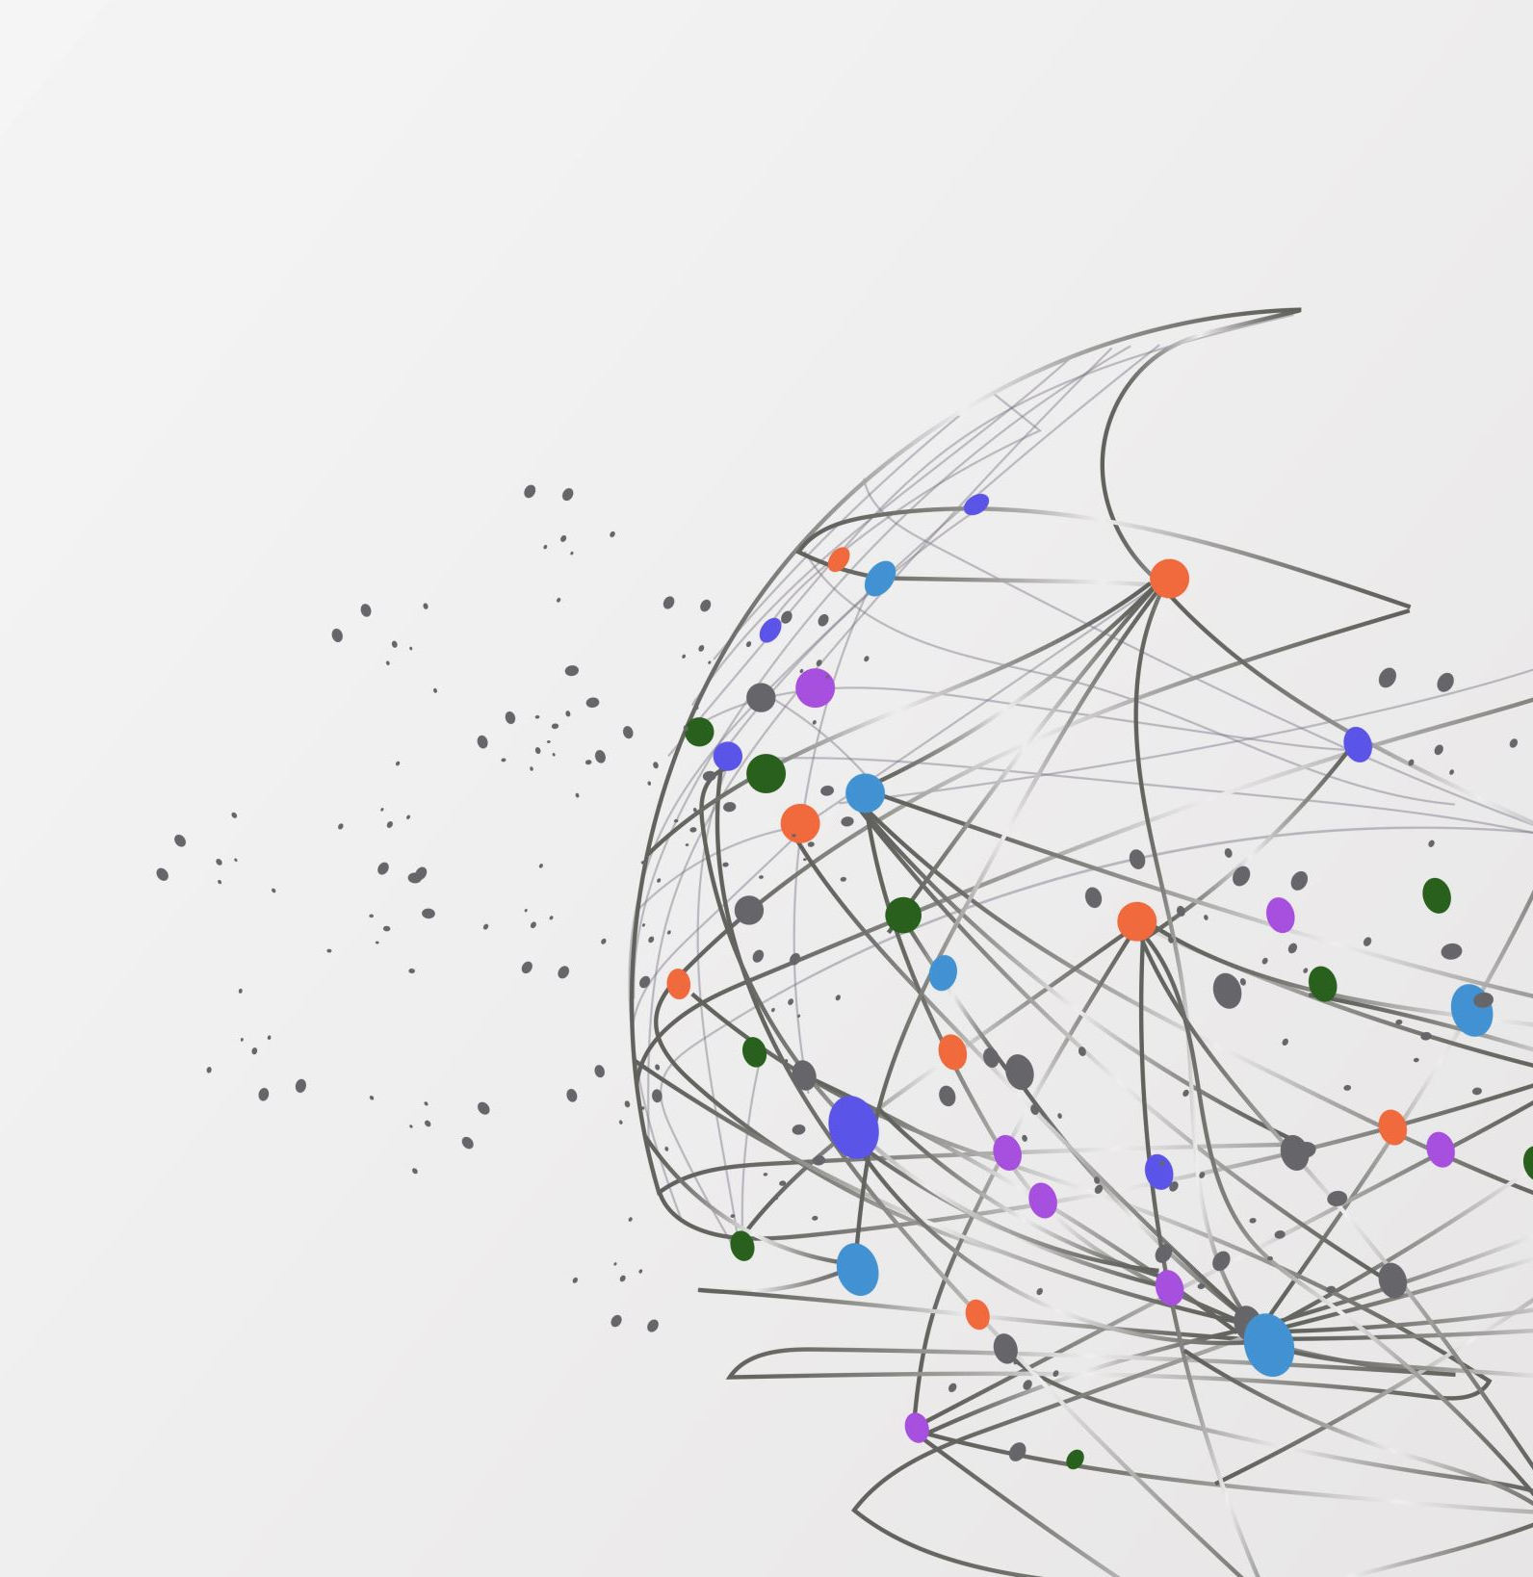
Subprime Crisis
Mathis Mourey
April 2024
HHS

Slide 2
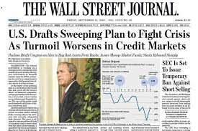


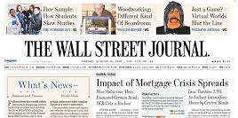
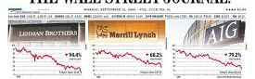

Slide 3

When a movie is actually a first-class course in Finance

Slide 4
Chapter I Plain old banking

Slide 5




Types of banks and borrowers
Prime
Subprime
Commercial banks
Investment banks

Slide 6


Good old mortgages
Market Value of the house
Interest + Capital
Collateral: The house
Buy
Take the example:
Mortgage = 200 000$
Interest = 5%
Maturity = 30 Years
How much interest paid in total?

Slide 7
Interest & Repayment
Total interest paid
186k
Monthly Payment
1073$
Source: https://www.calculatestuff.com/financial/loan-amortization-calculator

Slide 8
Chapter II The housing market

Slide 9
A bit of context
Very low interest rates to fight deflation after the Dot.Com bubble
Makes mortgages affordable
Higher demand for buying houses makes higher housing prices
Lower interest rates means less profit for commercial banks
Source: https://fred.stlouisfed.org/series/USSTHPI
Notes:
- Banks are searching for high-yields
- Change from “originate & hold” to “originate to distribute”

Slide 10

Damn capitalists
What happens if you cannot pay back your mortgage?
Sell the house to repay mortgage
Bank takes the house to sell it
In a context where house prices never went down, that’s a big incentive to provide mortgages (even to subprime profiles)
What could go wrong?
If the house prices go down then the bank will have to sustain losses when recovering the house and trying to sell it

Slide 11
Weird new mortgages
Interest-only Mortgage
Pay only interest
Continue as usual (Interest + Capital)
Adjusted-Rate Mortgage (ARMS)
Low (Teaser) Rate
Variable or higher Rate

Slide 12
Interest-only Mortgages
Total interest paid
200k
Monthly Payment
1169$
Source: https://www.calculatestuff.com/financial/interest-only-calculator

Slide 13
No more money Refinancing?
Existing Loan
Repayment
Bank 1
New Loan
Higher Repayment
Bank 2
Notes:
What happens when you refinance? Paid back the previous loan, get some extra money but increased annuities.

Slide 14
Chapter III Securitization

Slide 15

What happens when a bank reaches its lending limit?
Loan
Loan
$
$
Commercial Bank
Investment Bank
$
Asset Backed Security (ABS)

Slide 16

What the hell is a CDO?
A Collateralized Debt Obligation (CDO) is a type of ABS
Very safe
Low return
Senior
Mezzanine
Junior
CDO
Different tranches
Very risky
High return

Slide 17

Price of a CDO (or almost)
$P\left(L≤x\right)=φ(\frac{\sqrt{1−ρ}φ^{−1}\left(x\right)−φ^{−1}\left(p\right)}{\sqrt{ρ}})$

Slide 18
Who cares about the math?
The important thing is about correlation in defaults!
Family 1:
Lives in New York,
Middle class
Family 2:
Lives in Los Angeles,
Upper class
If family 1 defaults on its loan, does that impact the probability of default of family 2?
It turns that, if the reason for default is a common factor then yes it does

Slide 19
Let’s refocus before I lose everyone in mathematical details
Pricing model is wrong (make CDO look safe and hence cheap)
Investors all-around the world buy a lot of CDO
Investors think that they’re safe but actually not
The housing market slows down
Sub-prime profile cannot pay their mortgage and cannot refinance
Loans default in mass
CDO (value is based on loans not defaulting) become worthless
Investors all around the world realize big loss and try to sell their assets
Selling pressure creates a market crash

Slide 20
Chapter IV The Bubble Burst

Slide 21
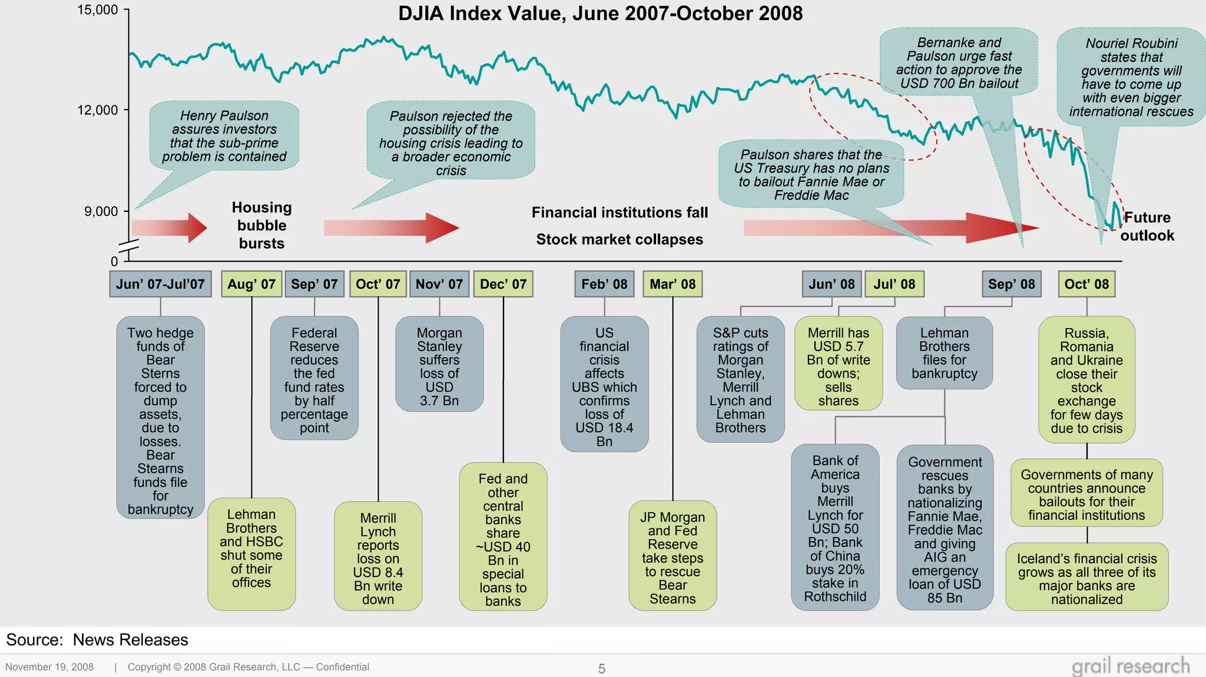

Slide 22
The “too-big-to-fail” issue
3
5
2
Bank 1
4
7
6

Slide 23
Chapter V Please tell me someone regulated that.

Slide 24
Short answer: Yes …
Dodd-Frank Act (2010): New regulators (FSOC) and better oversight of derivatives (like CDOs)
Basel (I, II & III): Committee on Banking Supervision that provides advice on banking regulations
Creation of the ERSB in Europe
Solvency (I & II) to regulate insurance companies as well
Creation of Stress-testing

Slide 25
… But, actually, not really
Regulation is backward looking
A financial crisis is never twice the same
New innovations lead to new risks

